Slide 1
ADVERTISING
Why is it so impotant in our society?
SPEAKING COURSE- ÁNGELA MERAYO
Notes:
Para cambiar la imagen de esta diapositiva, seleccione la imagen y elimínela. Después, haga clic en el icono Imágenes del marcador de posición para insertar su propia imagen.

Slide 2
Discuss the following questions
What is the funniest advertisement you have seen? Describe it.
What makes an ad memorable?
Do you buy products because of advertising?
Should advertisers be allowed to advertise to children?
What are the different methods of advertising?
What are the harmful and the beneficial effects of advertising?

Slide 3
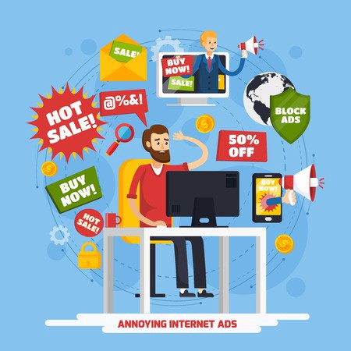
On-line advertising
Which of the online ads are the most annoying?
How often do you click an online ad or react to an ad (eg. a product you see on Facebook)?
What type of online marketing is the least intrusive?
Esta foto de Autor desconocido está bajo licencia CC BY

Slide 4
VIDEO AD
NATIVE AD
BANNER/DISPLAY AD
POP-UP AD
DEFINE
THESE WORDS
(HOMEPAGE) TAKEOVER AD
SOCIAL MEDIA AD

Slide 5
Discuss the following sentences in pairs
The company had a new product to sell so it decided to run an ad to get some business
Many adverts are only effective because they persuade people that they need products or services when in reality they don’t
Sometimes advertising is deceptive, you can’t believe a word they tell you
Many people try to keep up with the Jones’, so they are often very keen for people to see them buying the latest things
Some of the claims made in TV adverts are implausible, I’ll never know how people fall for them
“This new product of ours, it’s good, but if we don’t plug it on TV we won’t sell it.”
The company had just enough money in their budget to buy a slot on prime time TV, but only for ten seconds.

Slide 6
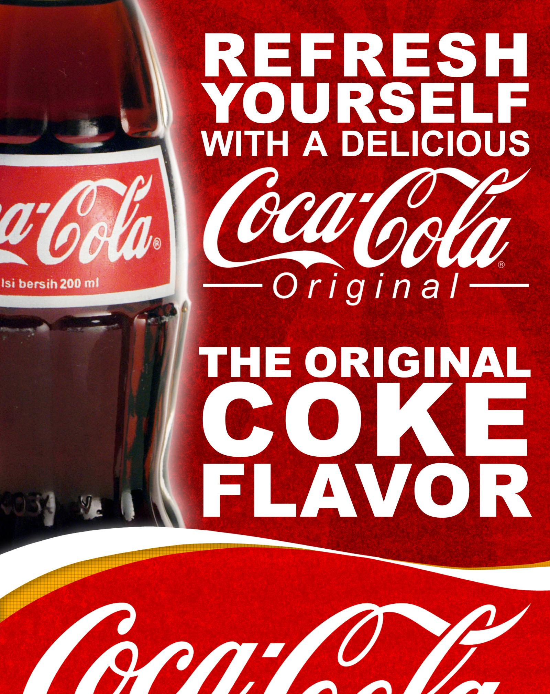
Think…
About the things you have in your house that have been advertised.
Who bought this product? Are you happy with it?
Where did you see it advertised?
Esta foto de Autor desconocido está bajo licencia CC BY-SA-NC

Slide 7
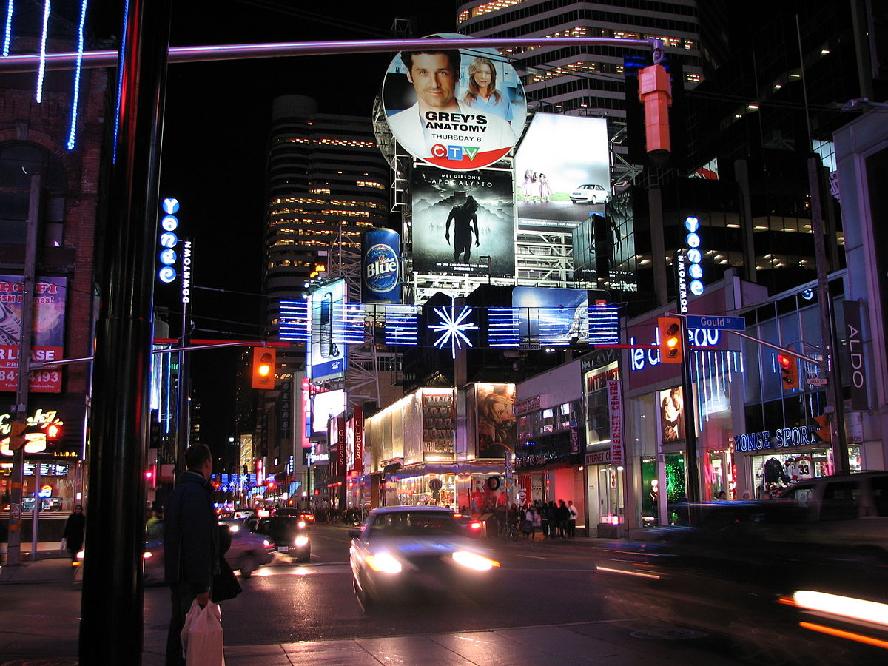
How to advertise
Make a list of how to advertise
Include the benefits of advertising
Would you pay a slot on prime time to advertise for example that you are looking for a flatmate?
Esta foto de Autor desconocido está bajo licencia CC BY-SA

Slide 8
Advertising situations
You want to advertise your company. It is not a new company but you lost money last month and you want new customers. You make plastic bottles for fizzy drinks. Decide who the customers are, and how to attract them.
You have just opened a new local flower shop. You don’t have a big budget so you need to be think carefully about how and where to advertise. You need to decide how and where to advertise.
You want to sell a new type of mobile phone. You have decided to advertise on TV. Decide when you want your ad to be broadcast so it can be seen by the maximum number of appropriate people.
You want a new flatmate. You must decide how to advertise so it will be seen by the type of person you want to live with.
You have invented a new kind of cooker, and you want to market this. You have plenty of money so you can use different media to advertise. Decide which two serve you best and why.
You want to sell your house but not using an estate agent. It is only a small house so the buyer will probably come from the local area. How will you advertise?

Slide 9
Advertising slogans
Make an impression with …
Blends beauty with performance
You can’t lose with a …
Sure to attract admiring looks
You’ll display yours with pride
A practical choice
Can we interest you in a … ?
All the smart money is going on …
This is a very popular item.
Perhaps you would like to consider …
Keeps you feeling and looking young
How could you be without a … ?
You’re never too old / young for a …
An eye-pleasing item
Enjoy the amazing beauty of …
Esta foto de Autor desconocido está bajo licencia CC BY-NC-ND

Slide 10
Your project
You are going to advertise a product with a classmate.
Decide what kind of product, what is the product for, if it is easy to tell, who it is suitable for, catchy slogan, nice appearance, etc.
Is it effective? Does the ad make you buy this product?
Then, go to canva.com and design it.
Next day in class, you’ll present it and the rest of the students will vote for the most popular ones.
Have fun!
Esta foto de Autor desconocido está bajo licencia CC BY-SA

