Slide 1
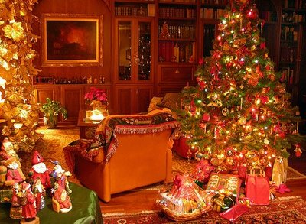
c
Christmas In England

Slide 2
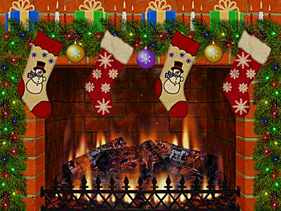
Christmas Eve (the 24th of December)
On Christmas eve we hang stockings over the fireplace.

Slide 3
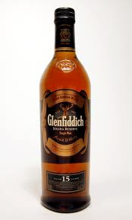
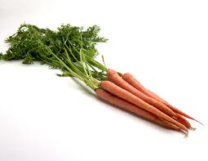
Christmas eve.
We leave whiskey and carrots for Father Christmas and his reindeer.

Slide 4
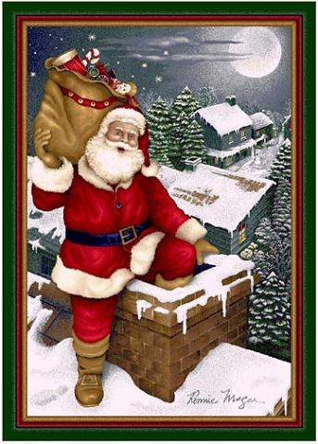
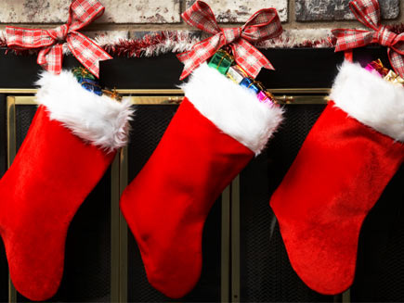
Christmas Eve night.
Father Christmas lands on the roof of the house, climbs down the chimney and fills the stockings with presents.

Slide 5
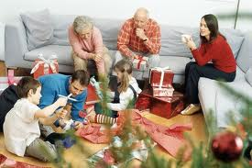
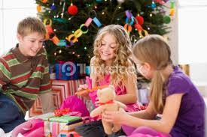
Christmas day (25th)
In the morning children get up very early to unwrap their presents from Santa Claus.
Then the whole family gets together to give each other presents.

Slide 6
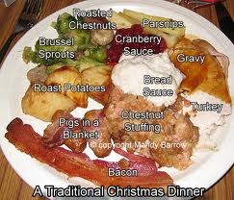
Christmas Dinner
At about 1pm the whole family sits down to eat Christmas dinner. The dinner consists of:

Slide 7
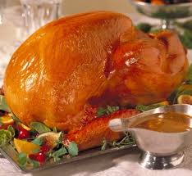
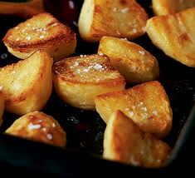
Xmas dinner:
Turkey, potatoes,

Slide 8
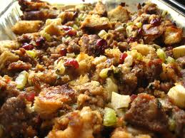
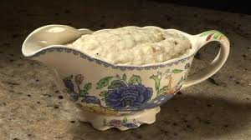
Xmas Dinner
Stuffing (a mixture of bread, herbs, spices and vegetables which is stuffed into the turkey while it cooks) and Bread sauce.

Slide 9
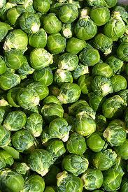
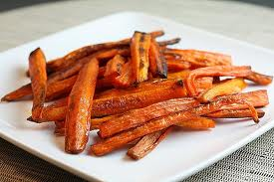
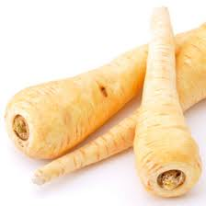
Xmas dinner
Brussel sprouts, carrots and parsnips.

Slide 10
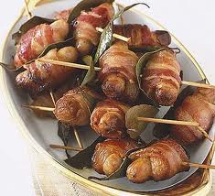
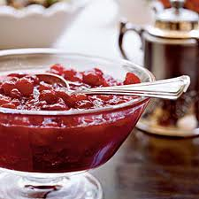
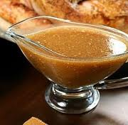
Xmas dinner
Pigs in blankets (sausages wrapped in bacon) cranberry sauce and gravy.

Slide 11
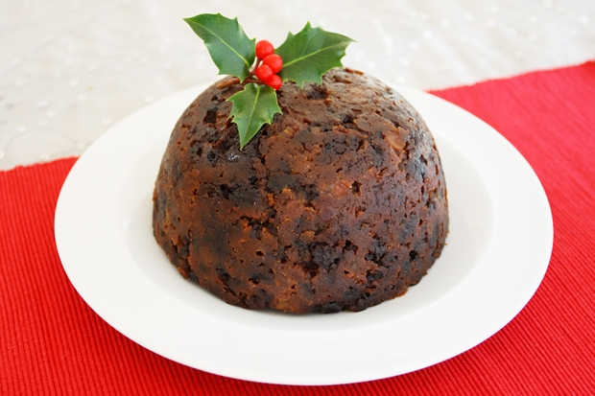
Christmas pudding
Christmas pudding is a mix of dried fruit, alcohol, breadcrumbs and spices. We usually make it a year in advance!

Slide 12
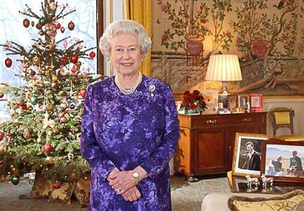
The Queen’s Speech
At 3pm every year the Queen makes a speech live on television and the whole country stops eating to watch it. The queen talks about what has happened that year.

Slide 13
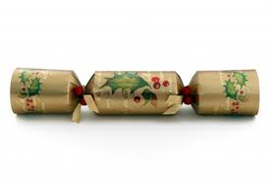
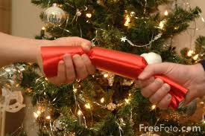
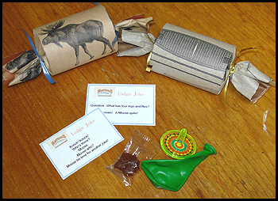
Crackers!
After dinner the family open Christmas crackers.
Cracker’s are cardboard tubes with a small explosive inside.
2 people pull the cracker until it explodes.
Inside there is a small present, a bad joke and a paper hat.

Slide 14
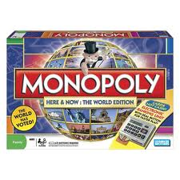
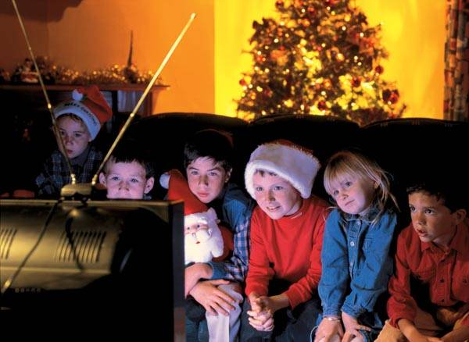
Christmas Day Evening
These activities change depending on the family. But generally familys play board games like Monopoly or Trivial Pursuit. Alternatively there are Christmas specials of all the most popular TV programs to watch.

Slide 15
A Traditional English Christmas
What can you remember? In your groups you have to try to remember as much information about an English Christmas as possible.
What do we do on Christmas Eve?
What do we do on Christmas Day?
What order do we do things?
What do we eat for Christmas dinner?
For every thing that you remember correctly you get 1 point, the winning team is the one with the most point.

