Slide 1
Art online
Building a museum of museums on the web

Slide 2
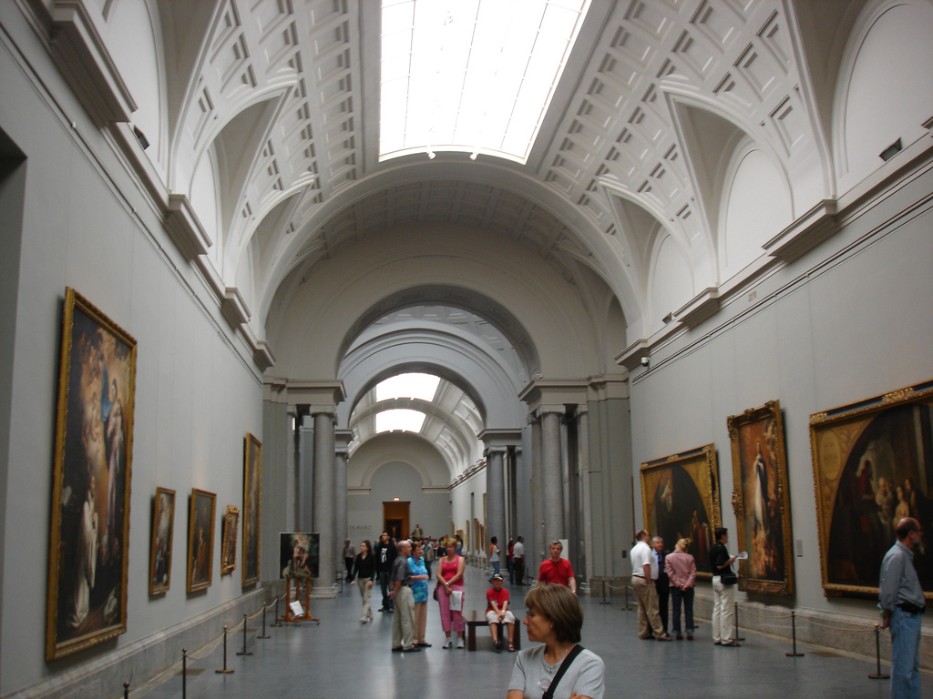
Do you like Art?
What comes to your mind when you hear the word museum?
What is the best museum in the world?
What’s the best museum you’ve ever been to?
What do you like most and least about museums?
Do you think museums should be free to enter?
Do you prefer going to museums alone or with others? Why?
Would a museum dedicated to your life be interesting?
What exhibitions are on at the momento that you would like to see?
Esta foto de Autor desconocido está bajo licencia CC BY-SA

Slide 3
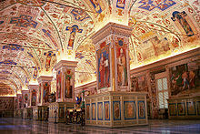
Do you agree with the statements?
Museums shouldn’t be funded by the government, that’s a really waste of money.
Esta foto de Autor desconocido está bajo licencia CC BY-SA
Most museums are outdated and that’s why they are not interesting anymore
Kids should be taken to museums to get used to art from an early age.
If all museums were for free, more people would be interested in art.

Slide 4
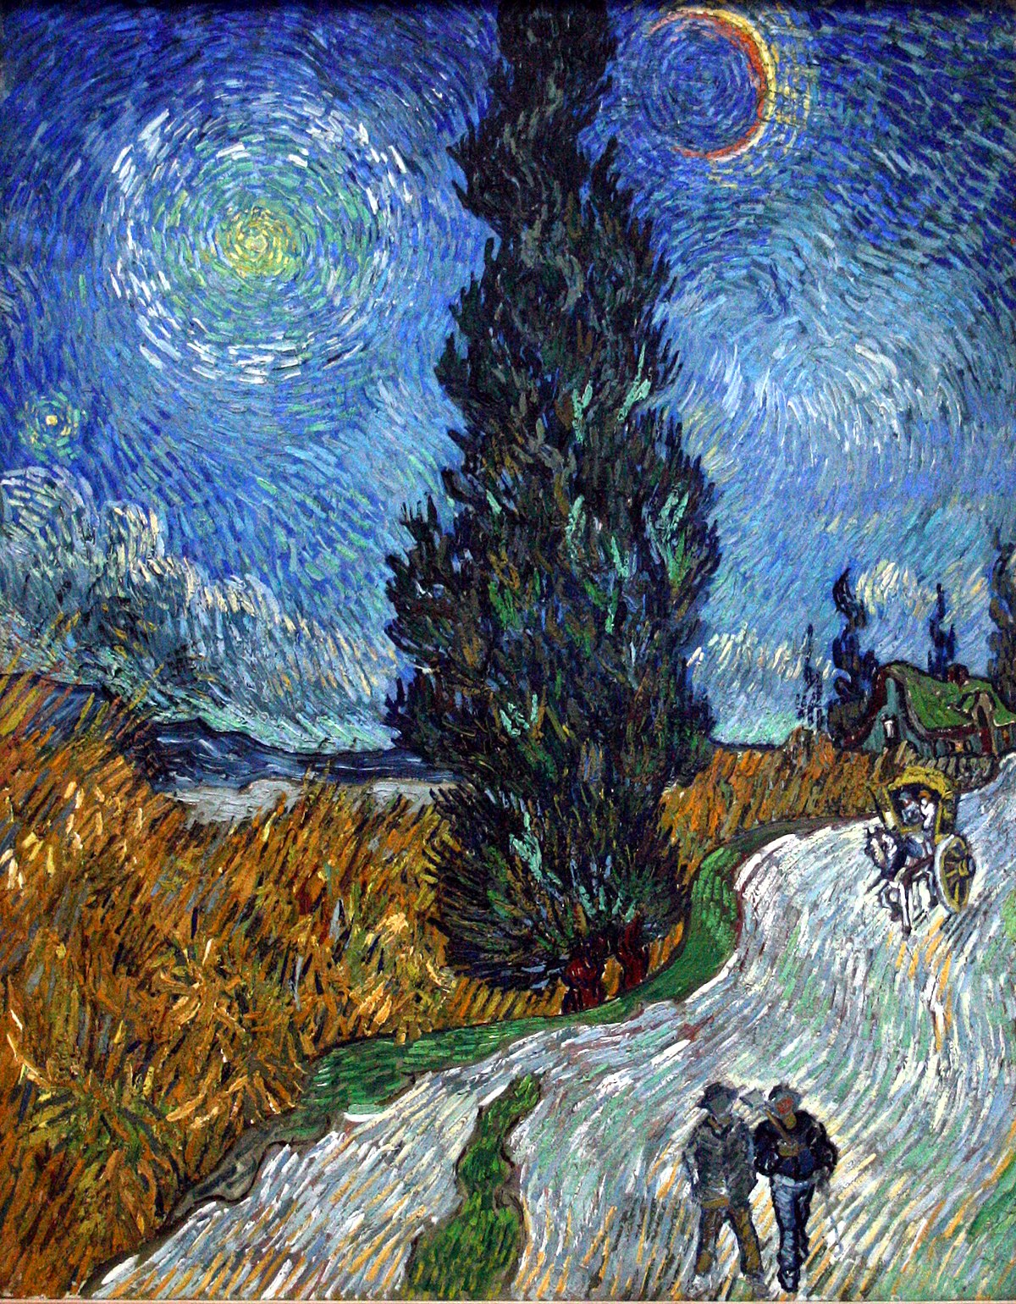
Discuss these questions
Are you into art? Which do you enjoy more photography, painting, sculpture or graffiti?
Do you think you have great museums/ art galleries in your city?
What was the best/ worst exhibition you’ve ever seen?
Esta foto de Autor desconocido está bajo licencia CC BY-SA

Slide 5
Vocabulary Match the words with their meanings
We stayed at some FANCY hotel in the city centre.
‘Vertigo’ is the film widely regarded as Hitchcock’s MASTERPIECE.
I PITCHED this idea of this new product to my bosses and they liked it.
The look on his face was absolutely PRICELESS.
Our research is SUPPLEMENT with material from some interview.
Information about this problema should be ACCESSIBLE to all people.
Unfortunately, he can’t REPLICATE his success from 2005.
Try to convince someone to buy or accept something.
Easy for anyone to get and use.
An excellent paintimng, book, or the best work of that particular artist.
Do or make something again in the same wqay as before.
Expensive, popular and fashionable.
Add an extra element or amount to.
Very valuable and impossible to replace.

Slide 6
Watch the video and answer the questions
What was the idea that he PITCHED to his boss?
What do you think about the idea that all museums collections can be ACCESSIBLE to everyone online? Will people become more interested on art?
Can the speaker’s idea REPLICATE the experience of going to a museum?
What PRICELESS works of art would be in your collection that you could create online?

Slide 7
Some useful websites of museums online
BRITISH MUSEUM
https://britishmuseum.withgoogle.com/
GUGGENHEIM IN NEW YORK
https://artsandculture.google.com/streetview/solomon-r-guggenheim-museum-interior-streetview/jAHfbv3JGM2KaQ?hl=en&sv_lng=-73.95902634325634&sv_lat=40.78285751667664&sv_h=10.75703204567916&sv_p=0.06928383072430222&sv_pid=MfnUmHRyOSzMtY3vtYU05g&sv_z=0.9645743015259163
NATIONAL GALLERY OF ART, WASHINGTON
https://artsandculture.google.com/partner/national-gallery-of-art-washington-dc?hl=en
VAN GOGH MUSEUM, AMSTERDAM
https://artsandculture.google.com/partner/van-gogh-museum?hl=en
MUSEE DORSAY, PARIS
PERGAMON MUSEUM, BERLIN
https://artsandculture.google.com/entity/pergamon/m05tcm?hl=en
https://artsandculture.google.com/partner/musee-dorsay-paris?hl=en
UFINZY GALLERY, FLORENCE
https://artsandculture.google.com/partner/uffizi-gallery?hl=en

