Slide 1
Let’s talk about movies!!!
How much do you know about them?
PASSIVE VOICE

Slide 2
Do you know where…?
WHERE IS THE FILM SET?
IN WHICH COUNTRY DOES THE ACTION TAKE PLACE?

Slide 3
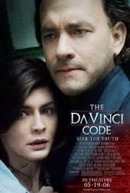
The Da Vinci Code
WHERE IS THE FILM SET?
IN WHICH COUNTRY DOES THE ACTION TAKE PLACE?
Paris- London

Slide 4
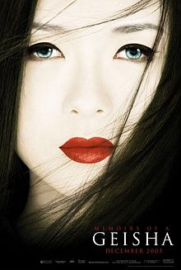
Memoirs of a Geisha
WHERE IS THE FILM SET?
IN WHICH COUNTRY DOES THE ACTION TAKE PLACE?
Japan-America

Slide 5
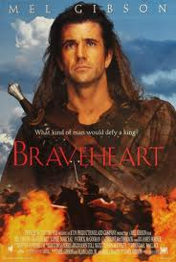
Brave Heart
WHERE IS THE FILM SET?
IN WHICH COUNTRY DOES THE ACTION TAKE PLACE?
Scotland

Slide 6
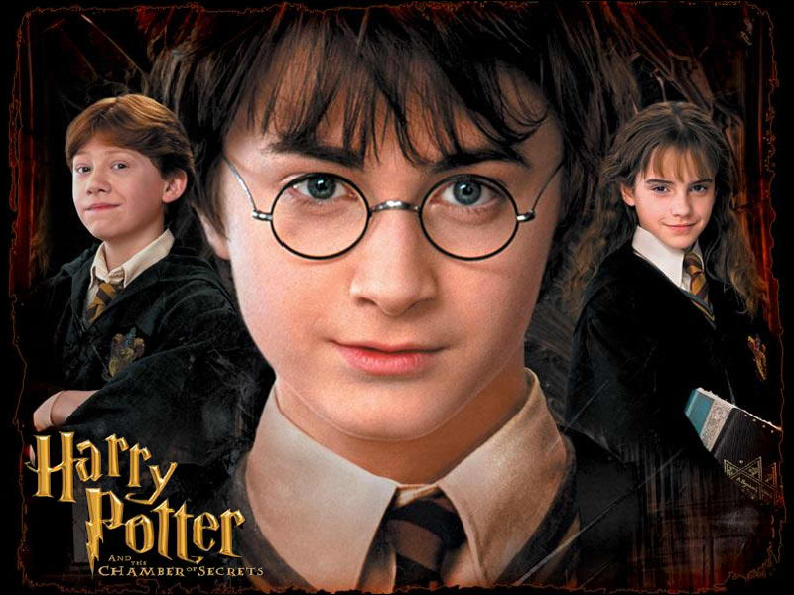
Harry Potter
WHERE IS THE FILM SET?
IN WHICH COUNTRY DOES THE ACTION TAKE PLACE?
England

Slide 7
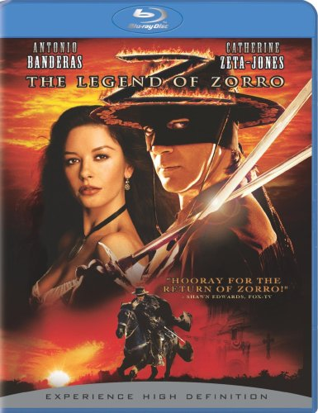
Zorro
WHERE IS THE FILM SET?
IN WHICH COUNTRY DOES THE ACTION TAKE PLACE?
Mexico

Slide 8
GRAMMAR
PASSIVE
= be + past participle (V3)

Slide 9
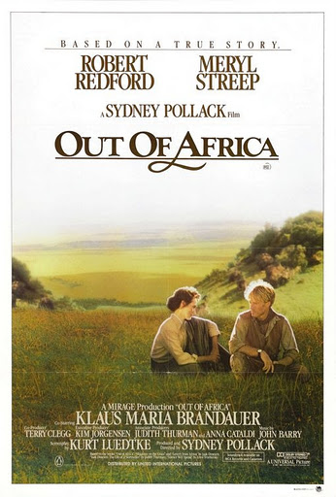
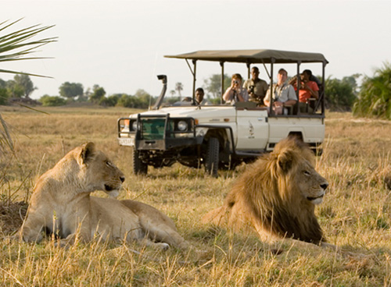
ACTIVE PASSIVE
Films inspire people to travel.
People are inspired to travel by films.

Slide 10
Passive formation:
Active: Films inspire people to travel.
Passive: People are inspired to travel by films.
(am/is/are + V 3)

Slide 11
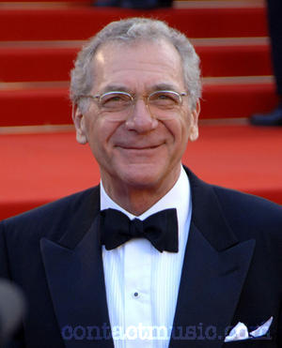
Active Passive
Sydney Pollack directed Out of Africa.
Out of Africa was directed by Sydney Pollack.

Slide 12
Passive formation:
Sydney Pollack directed Out of Africa.
Out of Africa was directed by Sydney Pollack .
(was/were + V 3)

Slide 13
Now you try …
Active: They’re making the film on location.
Passive: The film …………... on location.
Am/is/are BEING V3

Slide 14
Solution:
Active: They’re making the film on location.
Passive: The film is being made on location by them.

Slide 15
Now you try …
Active: They will release the film next year.
Passive: The film …………… next year.
will BE V3

Slide 16
Solution
Active: They will release the film next year.
Passive: The film will be released next year.

Slide 17
Now you try …
Active: Thousands of fans have visited the country.
Passive: The country….by thousands of fans.
Has/have BEEN V3

Slide 18
Solution
Active: Thousands of fans have visited the country.
Passive: The country has been visited by thousands of fans.

Slide 19
Active Passive
1.He washes the car.
2.He washed the car.
3.He is washing the car.
4.He was washing the car.
5.He has washed the car.
6.He has been washing the car.
7.He had washed the car.
8.He will wash the car.
9.He is going to wash the car.
10.He can wash the car.
11.He should wash the car.
12.He must wash the car.
13.He has to wash the car.
1.The car is washed by him.
2.The car was washed by him.
3.The car is being washed by him.
4.The car was being washed by him.
5.The car has been washed by him.
6.The car has been washed by him.
7.The car had been washed by him.
8.The car will be washed by him.
9.The car is going to be washed by him.
10.The car can be washed by him.
11.The car should be washed by him.
12.The car must be washed by him.
13.The car has to be washed by him.*

Slide 20
CORRECT THE MISTAKES
1. Lada cars made in Russia.
…
Lada cars are made in Russia.

Slide 21
2. A new motorway is being build at the moment.
…
A new motorway is being BUILT at the moment.

Slide 22
3. This programme were watched by millions of people.
…
This programme was watched by millions of people.

Slide 23
4. My bag was stole when I was in Florida.
…
My bag was stolen when I was in Florida.

Slide 24
5. The Harry Potter books were written for JK Rowling.
…
The Harry Potter books were written by JK Rowling.

Slide 25
6. I couldn’t send you an e-mail because my computer was repairing.
…
I couldn’t send you an e-mail because my computer was being repaired.

Slide 26
7. You will taken to your hotel by taxi.
…
You will be taken to your hotel by taxi.

Slide 27
8. Oh no! Our flight has being cancelled.
…
Oh no! Our flight has been cancelled!

Slide 28
9. English is spoke in this restaurant.
…
English is spoken in this restaurant.

Slide 29
10. Seat belts must wear at all times.
…
Seat belts must be worn at all times.

Slide 30
REWRITE SENTENCES WITH THE PASSIVE
1. They sell cold drinks here.
…
Cold drinks are sold here.

Slide 31
2. They subtitle a lot of foreign films.
…
A lot of foreign films are subtitled.

Slide 32
3. Someone threw the letters away by mistake.
…
The letters were thrown away by mistake.

Slide 33
4. Some people are painting my house.
…
My house is being painted.

Slide 34
5. They have sold all the tickets for the concert.
…
All the tickets for the concert have been sold.

Slide 35
6. They will play the match tomorrow.
…
The match will be played tomorrow.

Slide 36
7. Somebody must pay this bill tomorrow..
…
This bill must be paid tomorrow.

Slide 37
VOCABULARY
TRY TO REMEMBER THE WORDS

Slide 38
1. The music from a film
The s __ __ __ __ __ __ __ __ __
The soundtrack

Slide 39
2.The person who makes a film
The d__ __ __ __ __ __ __
The director

Slide 40
3.All the actors in a film
The c __ __ __
The cast

Slide 41
4.All the people who make a film
The f __ __ __ c __ __ __
The film crew

Slide 42
5.Filmed in the real place, not in a studio
O__ l__ __ __ __ __ __ __
On location

Slide 43
6.The part of a cinema or TV where the image appears
The s__ __ __ __ __
The screen

Slide 44
VOCABULARY PAGE
1. Kinds of films

Slide 45
western

Slide 46
Action film

Slide 47
musical

Slide 48
Horror film

Slide 49
thriller

Slide 50
comedy

Slide 51
Science fiction

Slide 52
2.PEOPLE & THINGS
Match words and definitions and check your answers

Slide 53
1. All the people who act in a film are called …
cast

Slide 54
2.The most important actor or actress in a film
star

Slide 55
3.The person who makes a film
director

Slide 56
4.The music of a film
soundtrack

Slide 57
5.The story of a film
plot

Slide 58
6.A part of a film happening in one place
scene

Slide 59
7.The people who watch a film in the cinema
audience

Slide 60
8.A film which continues the story of an earlier film
sequel

Slide 61
9. Images, often created by a computer
Special effects

Slide 62
10. The words of the film
script

Slide 63
11.Person in a film who has a small, unimportant part
extra

Slide 64
12.Translation of the dialogue of a film into another language
subtitles

Slide 65
3. Verbs and phrases
MATCH

Slide 66
1.The film was set in the 19th century Italy and England.
A. He was the director.
B. It was situated in that place at that time.
C. This was her role in the film.
D. The actors originally spoke in English.
E. It was an adaptation of the book.
F. It was filmed in the real place, not in a studio.
B. It was situated in that place at that time.

Slide 67
2.It was based on a novel by EM Forster.
A. He was the director.
B. It was situated in that place at that time.
C. This was her role in the film.
D. The actors originally spoke in English.
E. It was an adaptation of the book.
F. It was filmed in the real place, not in a studio.
E. It was an adaptation of the book.

Slide 68
3.It was filmed/shot on location in Florence.
A. He was the director.
B. It was situated in that place at that time.
C. This was her role in the film.
D. The actors originally spoke in English.
E. It was an adaptation of the book.
F. It was filmed in the real place, not in a studio.
F. It was filmed in the real place, not in a studio.

Slide 69
4.It was directed by James Ivory.
A. He was the director.
B. It was situated in that place at that time.
C. This was her role in the film.
D. The actors originally spoke in English.
E. It was an adaptation of the book.
F. It was filmed in the real place, not in a studio.
A. He was the director.

Slide 70
5.Helena Bonham-Carter played the part of Lucy.
A. He was the director.
B. It was situated in that place at that time.
C. This was her role in the film.
D. The actors originally spoke in English.
E. It was an adaptation of the book.
F. It was filmed in the real place, not in a studio.
C. This was her role in the film.

Slide 71
6.It was dubbed into other languages.
A. He was the director.
B. It was situated in that place at that time.
C. This was her role in the film.
D. The actors originally spoke in English.
E. It was an adaptation of the book.
F. It was filmed in the real place, not in a studio.
D. The actors originally spoke in English.

Slide 72
SPEAKING
Answer the questions
THE CINEMA QUESTIONNAIRE

Slide 73
Can you think of a film which…?
Made you laugh a lot
Made you cry
Sent you to sleep
Made you feel good
You’ve seen several times
Made you buy the soundtrack

Slide 74
Do you prefer…?
Seeing films on TV or DVD, or in the cinema
Seeing foreign films dubbed or with subtitles
Films from your country or American films

Slide 75
Think of a really good film you’ve seen this year:
Where was it set? When?
Who was in it? Who was it directed by?
Did it have a good plot?
What was the soundtrack like?

Slide 76
Have you ever…?
Met a film actor or director
Used a video camera
Appeared in any kind of film
Seen a film being made

