Slide 1
ORDER OF ADJECTIVES
… WHEN WE DESCRIBE SOMEONE:

Slide 2
Follow this order:
1. HEIGHT (short / tall …)
2. BUILD (overweight / fat / slim / thin …)
3. AGE (young / middle-age / old …)
4. HAIR: lenght + style + colour (eg. short curly dark)
5. FACE (round / oval / square …)
6. COMPLEXION (sun tunned / pale …)
7. EYES: size + shape + colour (e.g. small round blue)
8. EXTRA FEATURES (beard / tato / moustache …)
9. CLOTHES (casual / smart / neat …)

Slide 3
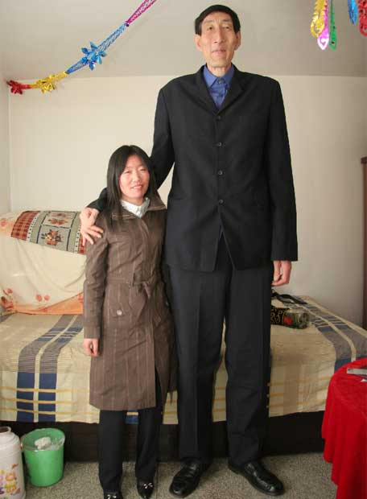
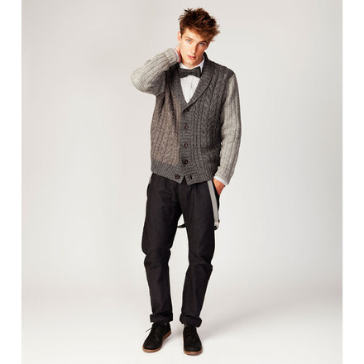
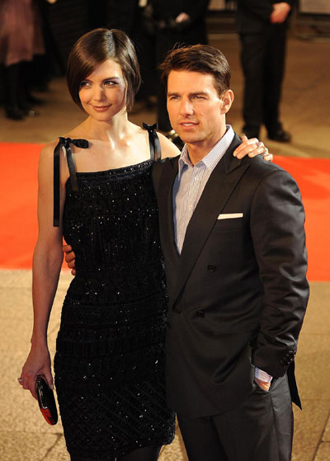
1. HEIGHT
tall (very tall / quite tall / not very tall)
average height
short (very short / quite short / not very short)
He is very tall.
He is quite tall.
He is not very tall.

Slide 4
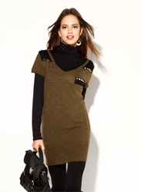
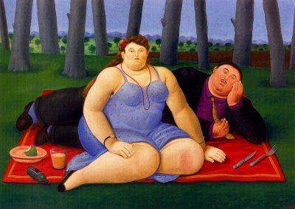
2. BUILD
overweight / fat / chubby
well built
skinny / thin / slim / fit
She is (very / quite / not very)…
- fat.
overweight.
chubby.
She is
(very / quite / not very)…
skinny.
- thin.
slim.
muscular.
fit.

Slide 5
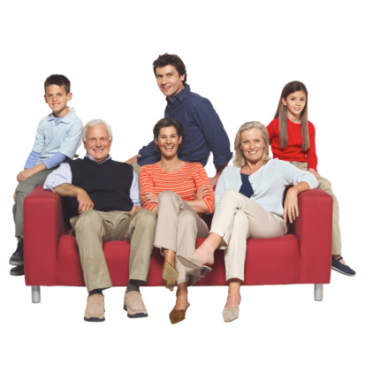
3. AGE
old
middle-aged
young
He is …
- a baby.
- a child.
- a teenager.
- a young man / woman.
- young.
- an adult.
- middle-aged.
- old.
- in his twenties.
- about 20 years old.
- twentyish.
- twenty something.
Other expressions:
To be in your teens.
To be in your early- / mid- / late-thirties.

Slide 6
4. HAIR: lenght + style + colour
STYLE
· She has …
- curly hair.
- straight hair.
- wavy hair.
· He is … bald
LENGTH
She has …
- long hair.
- short hair.
- medium lenght hair.
- shoulder length hair.
COLOUR
She has …
- black hair.
- fair hair. (bond/blonde)
- dark hair.
- red hair.
- gray hair.
- going gray hair.
- light brown hair.
- white hair.
Examples:
He has…short straight dark hair.
She has …long curly fair hair.

Slide 7
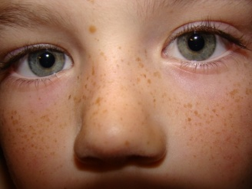
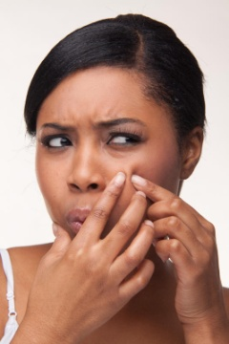
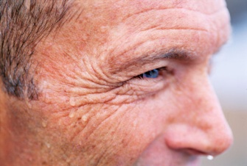
5. FACE
Examples:
He has…
- an oblong face.
- a rectangle face.
- a round face.
- a square face.
- an inverted triangle face.
- a heart face.
- a diamond face.
- a triangle face.
- an oval face.
He has…
freckles.
wrinkles.
pimples.

Slide 8
6. COMPLEXION
He has…
- a sun tanned complexion.
- a pale complexion.
- a fair complexion.
- a dark complexion.
- a black complexion.
He has…
- dark skin. / He is African-American.
- fair skin / light skin.
- light-brown skin. / He is Asian.
- (sun) tanned skin.
- pale skin.

Slide 9
7. EYES: SIZE + SHAPE + COLOUR
SIZE
He has…
- big / large eyes.
- small eyes.
SHAPE
He has…
- round eyes.
- almond-shape eyes.
COLOUR
He has…
- brown eyes.
- black eyes.
- blue eyes.
- light-blue eyes.
- green eyes.
EXAMPLES:
He has…
- big round brown eyes.
- small almond-shape green eyes.

Slide 10
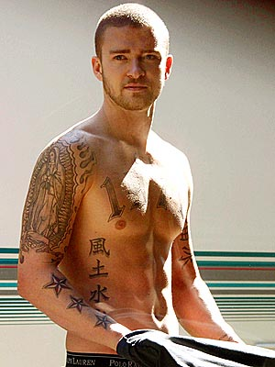
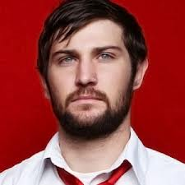
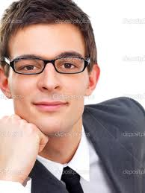
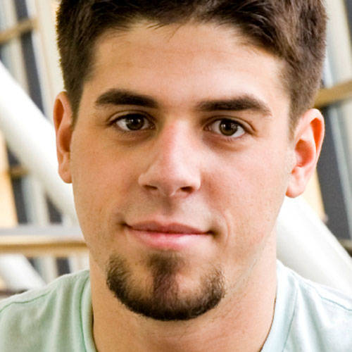
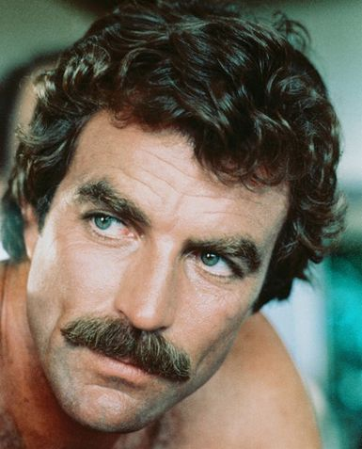
8. EXTRAFEATURES
He has …
- a beard.
- a goatee.
a moustache.
a tatoo.
He wears …
glasses.

Slide 11
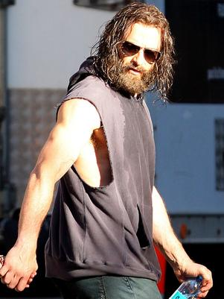
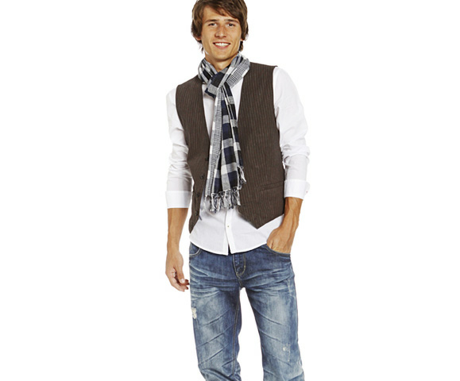
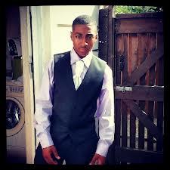
9. Dress
He is wearing…
- a smart (shirt) = an formal (shirt) = an expensive (shirt).
- a neat (shirt) = a clean (shirt).
- a new (shirt)
He is wearing…
- a casual (shirt) = an informal (shirt).
- a dirty (shirt) = an untidy (shirt).
- an old (shirt) = a worn out (shirt).

Slide 12
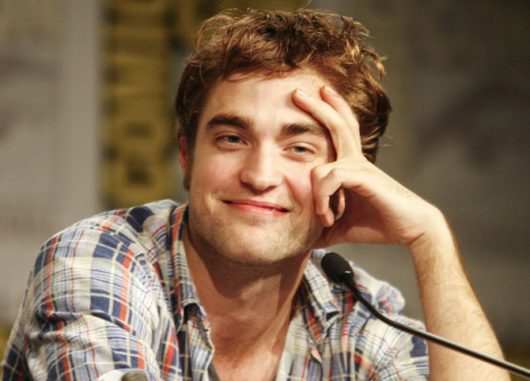
Now it’s your turn!! Make a full description of the images that you’ll see here…
Are you ready??

Slide 13
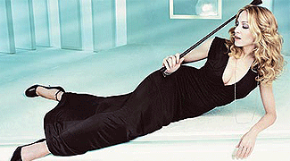
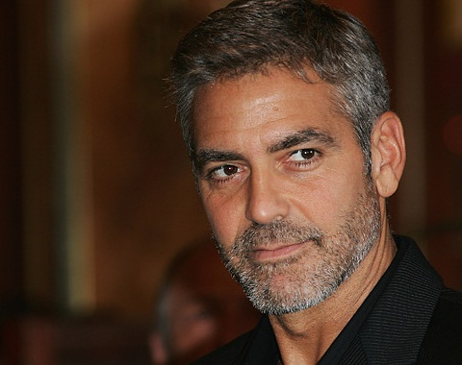

Slide 14
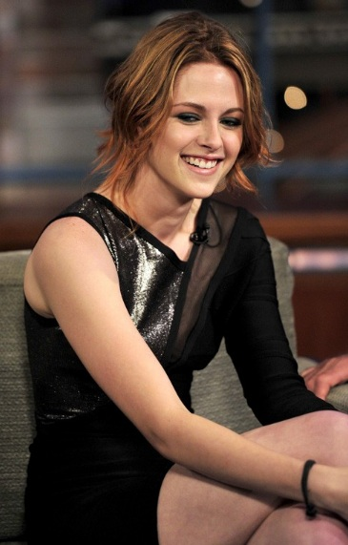
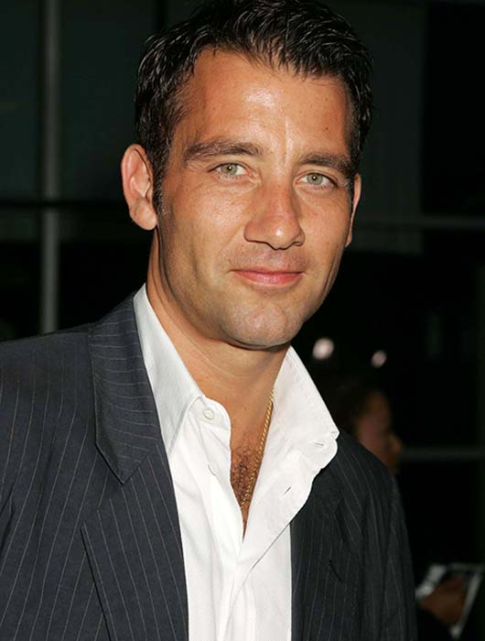

Slide 16
The End

